Slide 1



Slide 2

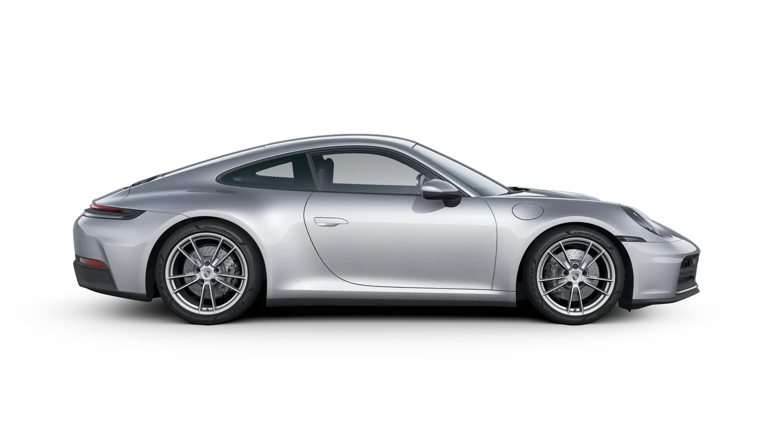
The 991 Turbo S
Our engineers like to talk about the most perfeact sports car ever. Incredible performance, whilst being confortable and fully suitable for everyday use. The 991 Turbo models continue this philosophy

Slide 3
The 991 Turbo S
Our engineers like to talk about the most perfeact sports car ever. Incredible performance, whilst being confortable and fully suitable for everyday use. The 991 Turbo models continue this philosophy

Slide 4
60 4HP
2,6 s
205 mph
Maximum power
0-60 mph
Top track speed
Turbo S
performance
For Porsche, the finish line is just a stepping stone in the continuous pursuit of further improvement.
Desing
From every angle a traditional athletic form: every detail combines timeless desing with contemporary style.
Comfort
Everyting new? Everything the same? Neither. The interior combines what has characterized the 911 Turbo for over 45 years with the possibilities of today.

Slide 5
60 4HP
2,6 s
205 mph
Maximum power
0-60 mph
Top track speed

Slide 6
The most perfect sportscar
PORSCHE 911

